Slide 1


Project : Busway Ticket Reservation System
Realized by . | DAOUI Naima ABASSI Khaoula | Supervised by | Pr. Omar EL BEGGAR

Slide 2
Plan
Introduction
Conception
DATA Storage
Realisation
Conclusion

Slide 3
Introduction | Conception | Data Storage | Realisation | Conclusion
Introduction :
The final realization of our project, the Busway Ticketing System, offers an innovative solution that enables users to book available journeys in real-time. It suggests finding ways to avoid the problems that passengers may encounter while using bus services, such as long wait times, overcrowding, delays, or confusion regarding schedules and ticketing, along with the waste caused by missed booked journeys.
Notes:
->"Hello, teacher. We are honoured to present in front of you the final realization of our project “

Slide 4
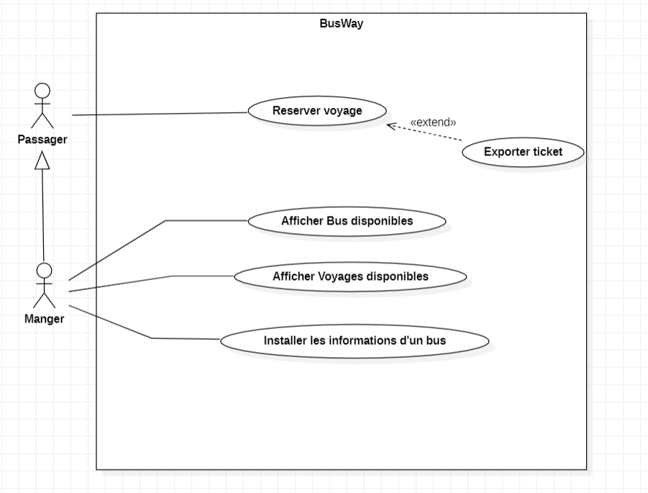
Introduction | Conception | Data Storage | Realisation | Conclusion
Use Case Diagram:
Notes:
Book for a journey , extends export ticket
Display available buses
Display availble journies per station
Install bus informations that includes creating a journey

Slide 5
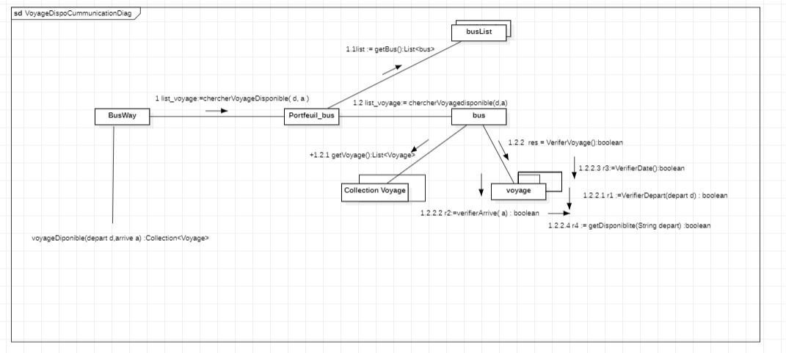
Introduction | Conception | Data Storage | Realisation | Conclusion
Communication Diagram « available journies»

Slide 6
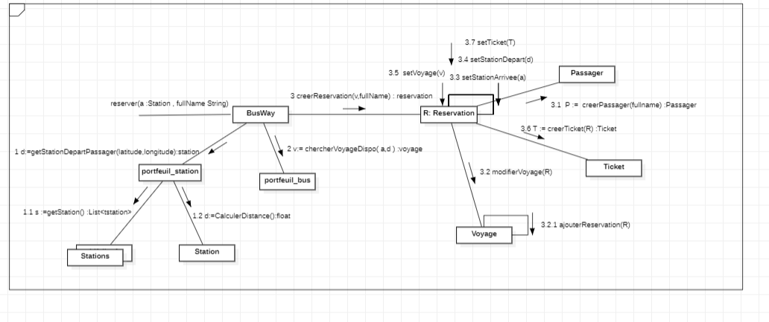
Introduction | Conception | Data Storage | Realisation | Conclusion
Communication Diagram « Book for a Journey »

Slide 7
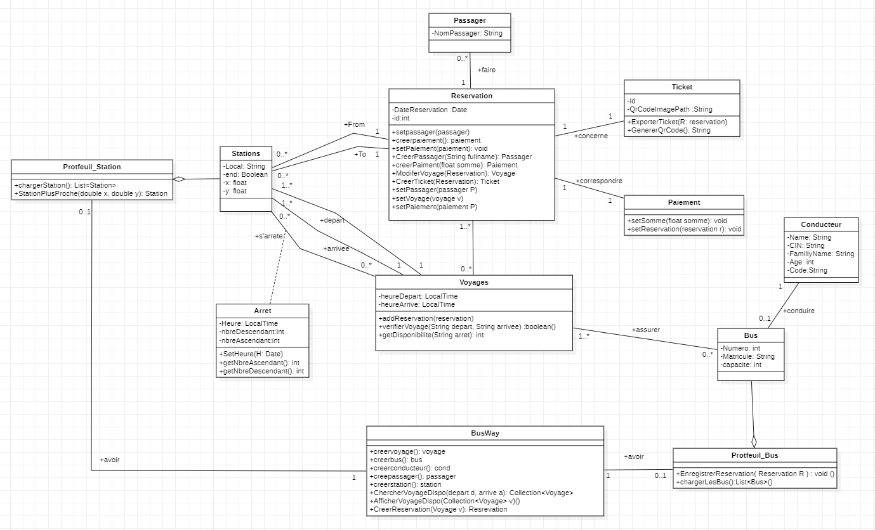
Introduction | Conception | Data Storage | Realisation | Conclusion
Class Diagram:
Notes:
Passing to the class diagramme we added the
->BUS Portfolio contains the function retrive buses retournes a list of buses
-> STATION portfolio that contains also retrives stations that returns a list of stations
Driver , journey, stations, portfolio, stops bye, start, arrival,

Slide 8
Introduction | Conception | Data Storage | Realisation | Conclusion
Graph Nodes:
Station Node:
Name: name of the station.
Latitude and Longitude: geographic coordinates of the station.
End: a boolean indicating if the station is the terminus of a journey.
Bus Node:
Matricule: bus registration number.
Capacity: the maximum number of passengers the bus can carry.
Driver: identifier of the driver associated with the bus.
Notes:
Graph Nodes:
Station Node: This node represents a station in our travel ticket reservation system. It is defined by the following attributes:
Bus Node: This node represents a bus in our system. It is characterized by the following attributes:

Slide 9
Introduction | Conception | Data Storage | Realisation | Conclusion
Graph Relationships:
Arret Relationship:
This relationship links a bus to a station, indicating that a bus stops at this station.
- Time: the time at which the bus stops at this station.
- NbreAsc: the number of passengers boarding the bus at this station.
- NbreDesc: the number of passengers disembarking from the bus at this station.
Next Relationship:
This relationship connects two stations, indicating that one station follows another in a travel journey.
Graph Relationships:
Arret Relationship:
This relationship links a bus to a station, indicating that a bus stops at this station.
- Time: the time at which the bus stops at this station.
- NbreAsc: the number of passengers boarding the bus at this station.
- NbreDesc: the number of passengers disembarking from the bus at this station.
Next Relationship:
This relationship connects two stations, indicating that one station follows another in a travel journey.
Notes:
Descending , Ascending

Slide 10
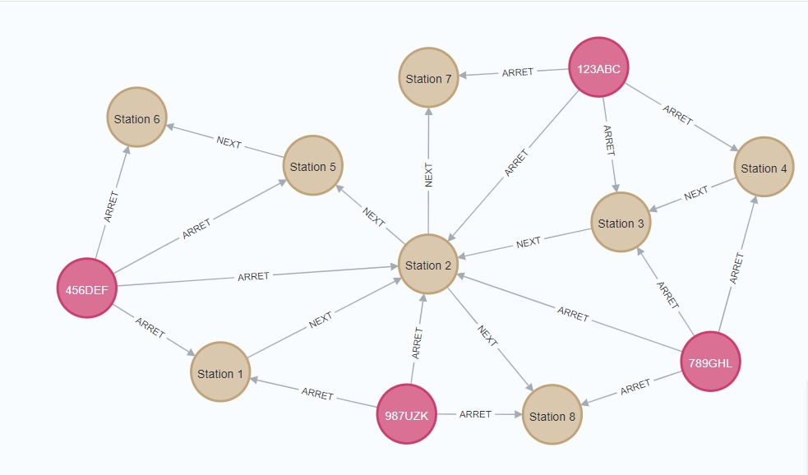
Introduction | Conception | Data Storage | Realisation | Conclusion
Representation of Journeys:
Each journey is represented by a list of relationships between stations, utilizing the "Next" relationship.
This approach allows for a clear itinerary for each trip, indicating the order of stations to be visited.
The journey start from a terminus station, identified by the "End" attribute equal to 1, and continues until reaching another terminus station, also marked by "End" equal to 1.
Every stop made during the journey is denoted by the "Arret" relationship between the bus and the relevant stations.
Notes:
As we can observe, each bus is connected to multiple stations where it stops using the "Arret" relationship. Additionally, these stations are interconnected through the "Next" relationships to form a journey.

Slide 11
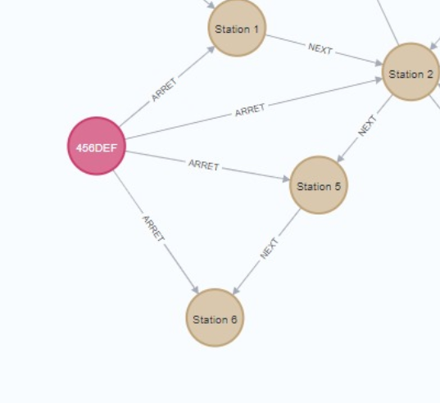
Introduction | Conception | Data Storage | Realisation | Conclusion
Representation of Journeys:
To determine the availability of a bus at a given station, we utilize the bus capacity as the basis for calculation. This involves subtracting the number of passengers boarding the bus at all previous stations of the journey (NbreAsc), and adding the number of passengers disembarking from the bus at these same stations (NbreDesc).
This approach enables us to obtain an accurate estimate of the number of available seats at the current station of the journey. By adjusting this calculation at each stop of the journey, we can provide real-time information on seat availability on the bus at each stage of the journey.
Notes:
As we can see in the graph, if we want to determine the availability of bus 456DEF at station 6, we calculate it by subtracting the number of passengers ascending at stations 1, 2, and 5 from the bus capacity, and then adding the number of passengers descending at these stations.

Slide 12
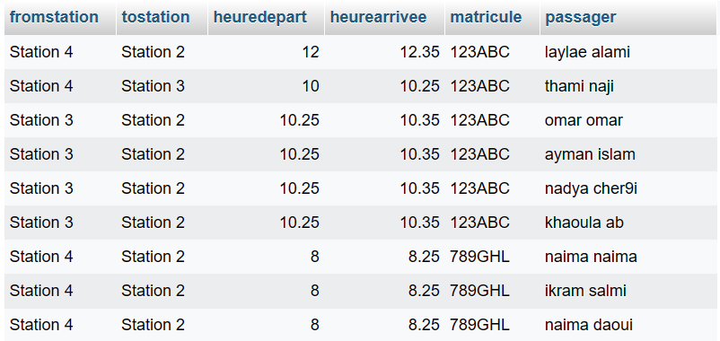
Introduction | Conception | Data Storage | Realisation | Conclusion
Bus Reservations:
Passager: the full name of the passenger.
matricule: the bus register.
Heuredepart, fromstation: the time and station name where the journey starts.
Heuredarrivee, tostation: the time and station name where the journey ends.
Notes:
To persist the data of reservations made by passengers and bus drivers, we used a MySQL database.
The details of each reservation are stored in a table named "reservation". This table contains the following fields:

Slide 13
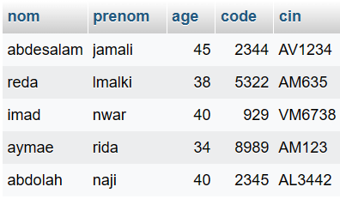
Introduction | Conception | Data Storage | Realisation | Conclusion
Bus Drivers:
Name: the name of the driver.
Surname: the surname of the driver.
Age: the age of the driver.
National Identity Card (CIN): the driver's national identity card number, serving as a unique identifier.
Notes:
We also utilized a table named "drivers", which contains the following fields:

Slide 14
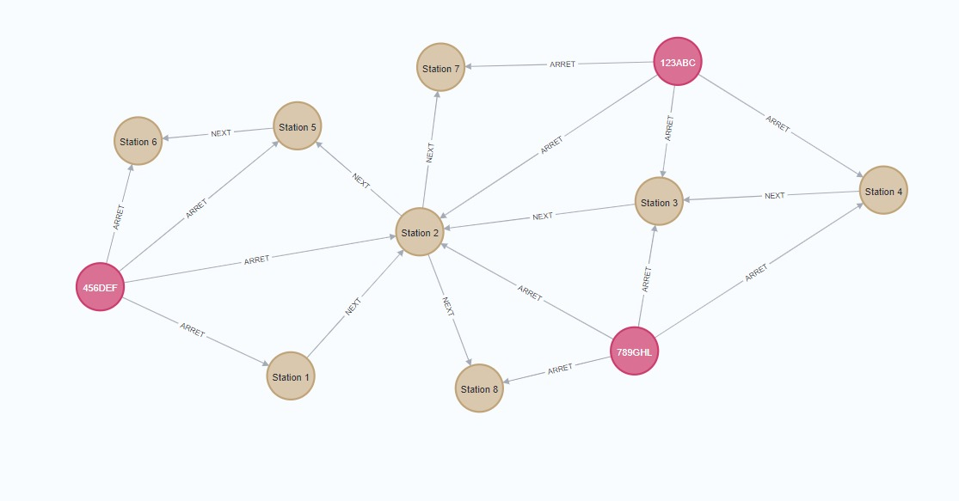
Introduction | Conception | Data Storage | Realisation | Conclusion
Notes:
We have worked on a graph with 3 buses, namely A, B, and C, which provide 3 trips. The first trip goes from station 1 to 2, then to 5, and finally to 6. The second trip goes from station 4 to 3, then to 2, and finally to 7. The third trip goes from station 4 to 3, then to 2, and finally to 8.

Slide 15
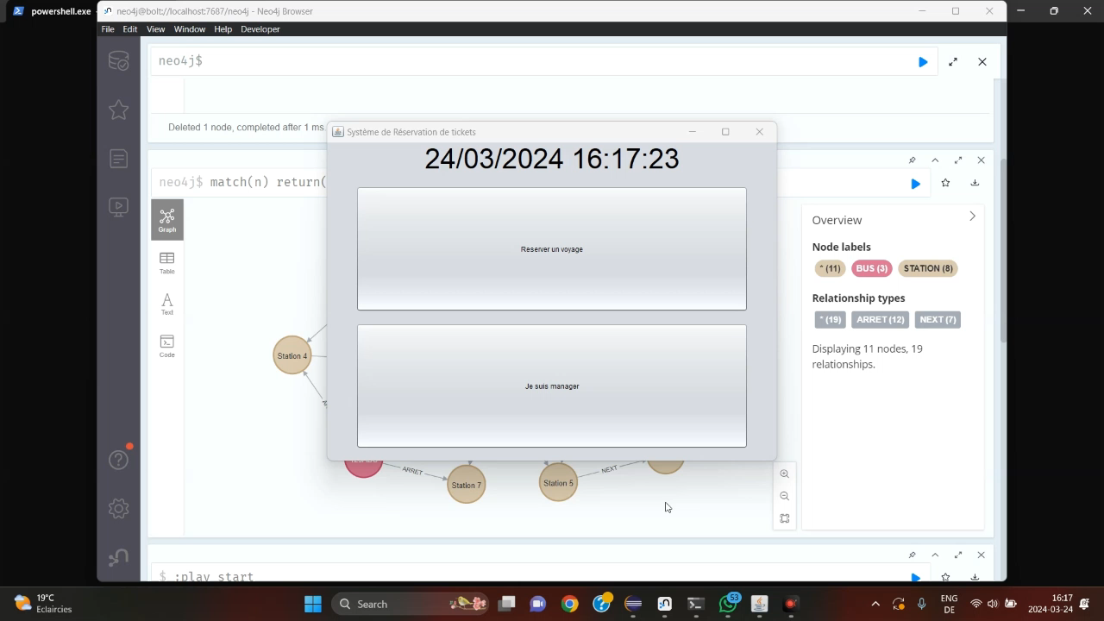
 | Introduction | Conception | Data Storage | Realisation | Conclusion
i
Notes:
Moving on to the video demonstration of the project realization
Here's the homepage interface with two buttons: one for passengers to reserve a journey and the other to log in to the administrator account.
Now we attempt to log in to the administrator account
Now, on the administrator's homepage, we have three options:
Firstly, to view the available journeys at specific stations.
Secondly, to check the available buses and the reservations made for each bus.
Finally, to add a new bus by entering the maximum passenger capacity, license plate, and selecting a driver from the retrieved list of drivers.
After adding a new bus, we observe that our bus node is added to the graph. Moving forward, we can add that a bus arrives at a station at a given time to form its journey."
Now, let's log in as a passenger. The controller is responsible for finding the nearest station to the passenger. Then, the passenger selects the desired destination station. Next, we display a list of available journeys that pass through these two stations. The passenger chooses a journey, and then we direct them to a confirmation page to enter their name. Upon validation, we generate a QR code and a ticket, which can be exported as a PDF. Here's our ticket."

Slide 16
Introduction | Conception | Data Storage |  | Realisation | Conclusion
Conclusion
Our implementation of this project has resulted in a system with fluid and intuitive interfaces. We extend our gratitude to our professor for their guidance and support throughout its development. Moving forward, we aim to enhance the system further by adding more functionalities and developing a chatbot from scratch
Notes:
Our travel ticket reservation system, leveraging Neo4j and MySQL databases, has provided us with valuable insights into graph database management and relational database systems. Through this project, we have acquired new skills in utilizing Neo4j's graph nodes and relationships to represent complex travel networks, as well as managing reservation data efficiently with MySQL.
We would like to express our sincere gratitude to our professor for their guidance and support throughout the development process. Their expertise and encouragement have been invaluable in helping us navigate the challenges and complexities of this project.

Slide 17
Thank your for your attention

Slide 18
Project : Busway Ticket Reservation System
Realized by . | DAOUI Naima ABASSI Khaoula | Supervised by | Pr. Omar EL BEGGAR

